Slide 1
IBM University Engagement Project Submission
“Exploring the Power of Agentic AI with IBM Granite and LangFlow”

Slide 2

Project Tile – LearnMate: Agentic AI for Personalized Course Pathways
Domain of Project – Education
Student Name | Recent Passport Photo | Email ID | Mobile number [WhatsApp]
Alisha Khan |  | alishak1280@gmail.com | 6267117405

Slide 3
Problem Statement -
Problem Statement No. 12 – Agentic AI for Personalized Course Pathways
The Challenge
Students often struggle to identify the right learning path that aligns with their interests and long-term career goals. The overwhelming number of online courses, lack of personalized guidance, and uncertainty about their current skill levels make it difficult to choose appropriate learning resources.
Traditional learning platforms generally provide predefined courses rather than dynamically adapting learning pathways to individual student needs.
The Objective
To develop LearnMate, an Agentic AI-powered learning coach that:
1. Understands students' interests, preferences, and career goals.
2. Assesses their current knowledge and skill levels.
3. Generates personalized, structured course roadmaps.
4. Recommends relevant courses based on skill levels and prerequisites.
5. Tracks learning progress and completed courses.
6. Dynamically adapts roadmaps based on student performance and changing goals.

Slide 4
Proposed Solution -
Proposed Solution: LearnMate – AI-Powered Personalized Learning Coach
LearnMate is an intelligent Agentic AI learning platform powered by IBM Granite and IBM watsonx.ai. It provides personalized learning guidance through an interactive AI coaching experience.
The system follows these key processes:
1. Personalized Student Onboarding: Collects student information, interests, preferred learning styles, current skill levels, career goals, and weekly study availability.
2. AI-Powered Skill Assessment: Evaluates existing knowledge and identifies the student's current learning level.
3. Personalized Roadmap Generation: Uses IBM Granite to generate structured learning pathways with suitable courses, prerequisites, skills, and estimated durations.
4. AI Learning Coach: Provides conversational guidance, answers technical questions, and supports students throughout their learning journey.
5. Adaptive Learning Pathways: Updates the roadmap according to completed courses, ongoing progress, and changing student goals.
6. Progress Tracking: Maintains student profiles, course completion records, learning progress, and estimated completion timelines.

Slide 5
Technology Used
IBM Granite: AI reasoning, personalized roadmap generation, skill assessment, and coaching responses.
IBM watsonx.ai: Provides access to IBM Granite foundation models and AI inference.
IBM Cloud IAM: Secure authentication using IBM Cloud API credentials.
Python: Core programming language for application logic and AI integration.
Flask: Backend web framework and REST API development.
HTML, CSS, JavaScript: Frontend interface and interactive user experience.
Pydantic: Student profile data validation and structured data management.
JSON: Persistent storage of student profiles and learning progress.
IBM Granite Model: ibm/granite-3-8b-instruct

Slide 6
Langflow component Used -
1. Student Onboarding Module: Collects student details, interests, skill levels, career goals, and weekly availability.
2. IBM Granite Client: Connects the application to IBM watsonx.ai and processes AI requests.
3. AI Coach Agent: Manages conversations, identifies student requirements, and provides personalized learning guidance.
4. Roadmap Generator: Creates structured course pathways using IBM Granite, with a rule-based fallback.
5. Course Catalog: Contains 40+ curated courses across 12 technology domains.
6. Student Profile Manager: Stores student information, preferences, conversation history, and learning progress.
7. Progress Tracker: Calculates course completion, remaining learning duration, and recommended next courses.

Slide 7
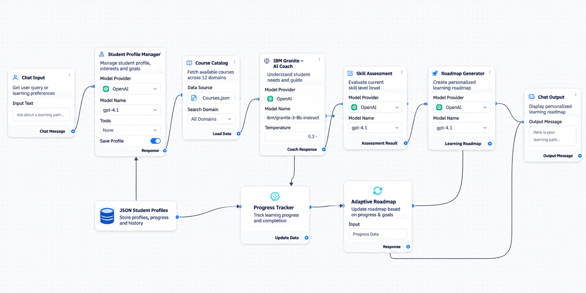
Langflow workflow -

Slide 8
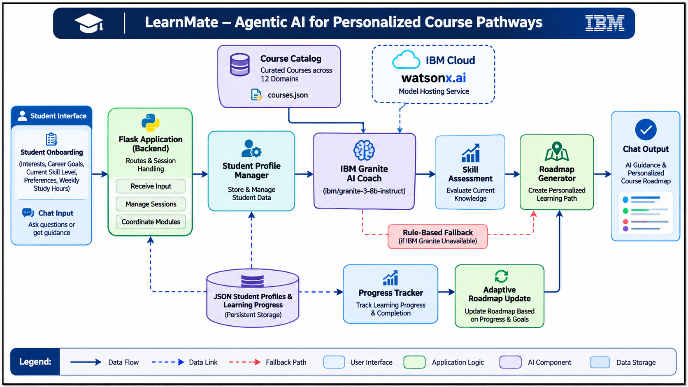
Architecture blueprint

Slide 9

Role of Agentic AI in the solution
Role of Agentic AI in LearnMate
Agentic AI enables LearnMate to work as an intelligent learning coach rather than a traditional chatbot. It understands student requirements, makes learning recommendations, performs specific tasks, and adapts learning pathways according to student progress.
Its key roles include:
- Autonomous Decision-Making: Determines suitable learning pathways based on student profiles and goals.
- Personalization: Uses student interests, skill levels, and learning preferences to customize recommendations.
- Intelligent Assessment: Evaluates existing knowledge and identifies skill gaps.
- Goal-Oriented Planning: Generates structured learning roadmaps with course prerequisites.
- Continuous Adaptation: Updates learning plans based on completed courses and student performance.
- Conversational Intelligence: Maintains conversation history to provide context-aware guidance.

Slide 10
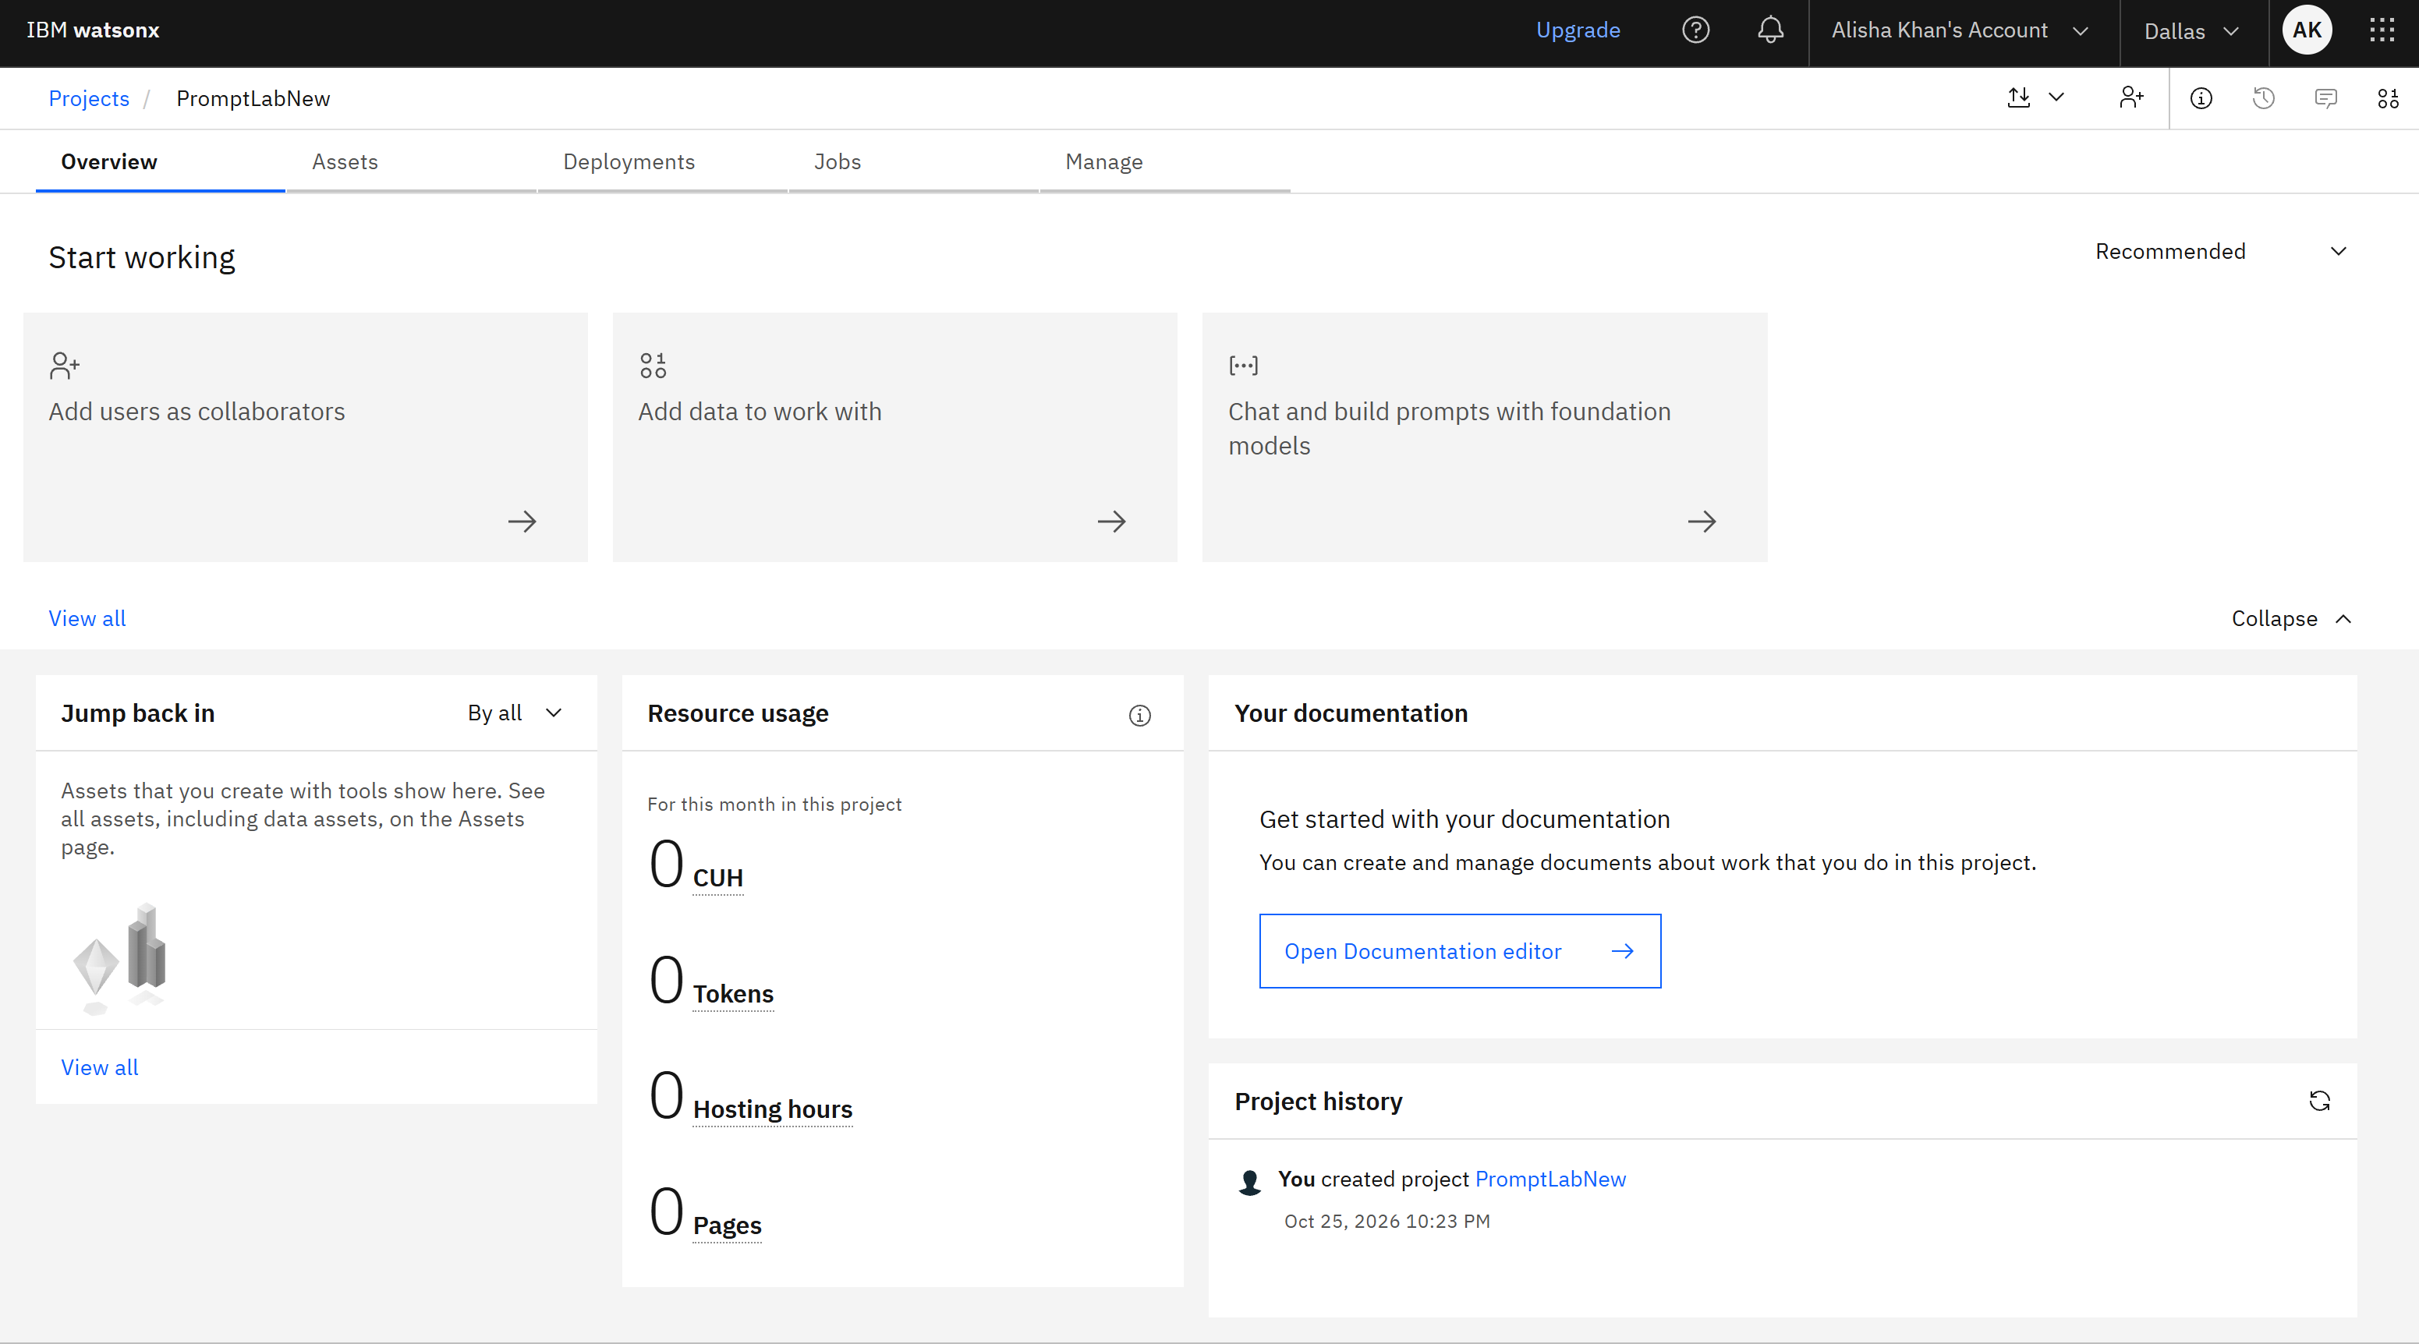
Token Usage
Before Prompt
After the Prompt
·
·
·

Slide 11
Novelty and Uniqueness
1. Personalized Learning Paths: Creates individual learning roadmaps instead of offering the same predefined courses to everyone.
2. Agentic AI Approach: Combines student understanding, assessment, planning, and adaptation in an intelligent coaching workflow.
3. IBM Granite Integration: Uses IBM Granite for natural language understanding, reasoning, and personalized recommendations.
4. Skill-Based Recommendations: Recommends courses according to existing knowledge and skill gaps.
5. Adaptive Roadmap Generation: Modifies future learning recommendations according to completed courses and progress.
6. Multi-Domain Learning: Supports 12 technology domains, including Frontend Development, Cybersecurity, UI/UX Design, and Data Science.
7. Persistent Student Profiles: Maintains student information and learning progress across sessions.
LearnMate is more than a course recommendation system; it is an intelligent, goal-oriented learning coach.

Slide 12
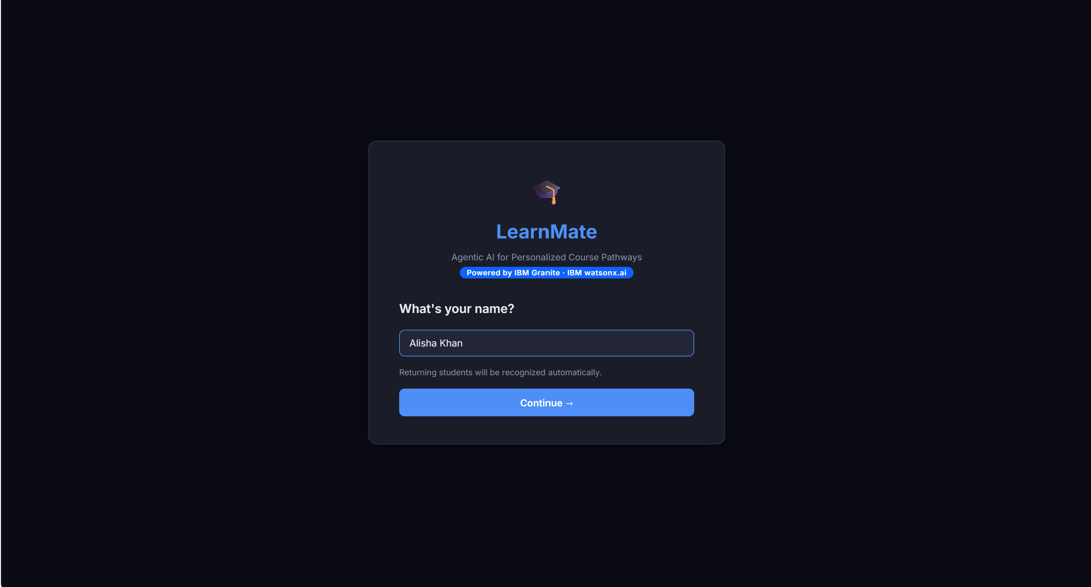
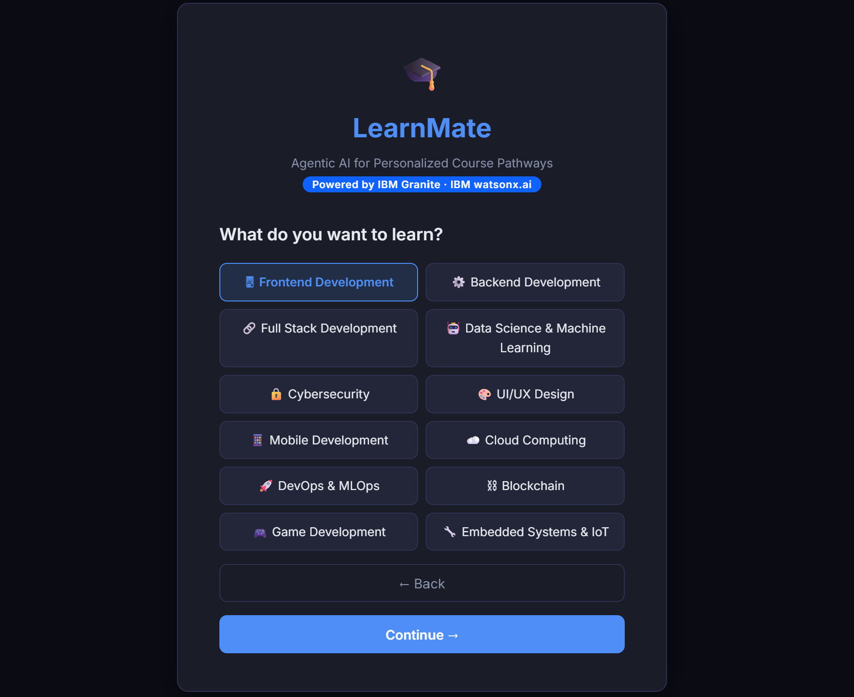
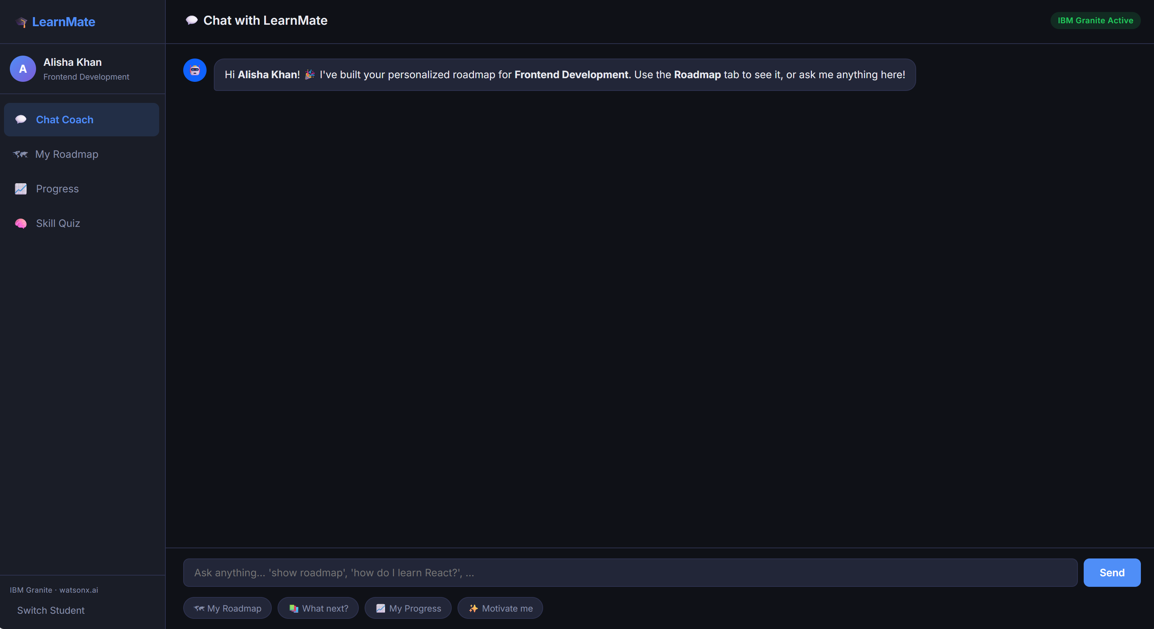
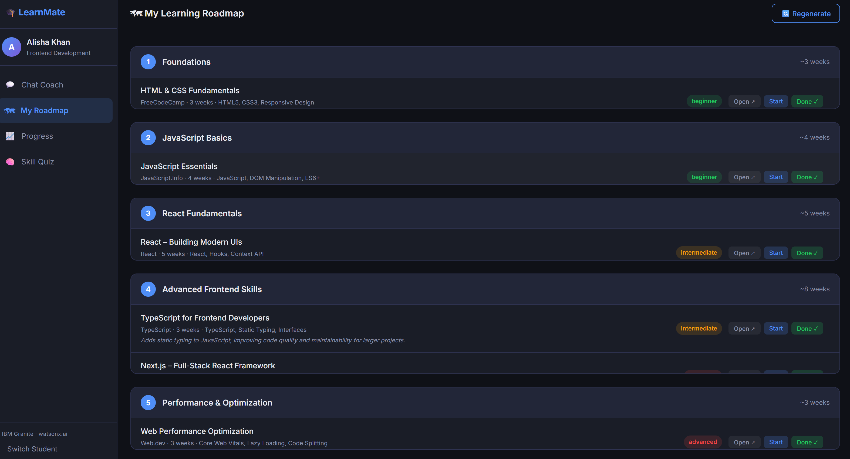
Git Hub Link
Project Repository
GitHub Repository: https://github.com/alishaaakhan/AICTE-AgenticAIforPersonalizedCoursePathways
Repository should contain:
1. app.py
2. main.py
3. learnmate/ folder
4. templates/ folder
5. static/ folder
6. requirements.txt
7. README.md
8. app.json
9. Problem statement PDF
10. Final project presentation PPTX
Some Snapshots of the Project :-
·
·
·

Slide 13
Future Scope
Future Enhancements of LearnMate
1. Advanced Skill Assessment: Introduce comprehensive assessments and practical coding challenges to evaluate students more accurately.
2. Multilingual AI Coach: Support multiple languages to make personalized learning accessible to students from different backgrounds.
3. Learning Analytics Dashboard: Provide detailed visualizations of student performance, skill development, and roadmap completion.
4. Integration with Online Learning Platforms: Connect with platforms such as Coursera, edX, and other learning providers to access additional learning resources.
5. AI-Based Career Guidance: Recommend career opportunities, job roles, and relevant skills based on students' learning progress.
6. Voice-Based AI Interaction: Allow students to communicate with LearnMate through voice conversations.
7. Cloud Deployment and Scalability: Deploy the platform using IBM Cloud services to support more students and improve accessibility.
·
·
·

Slide 14
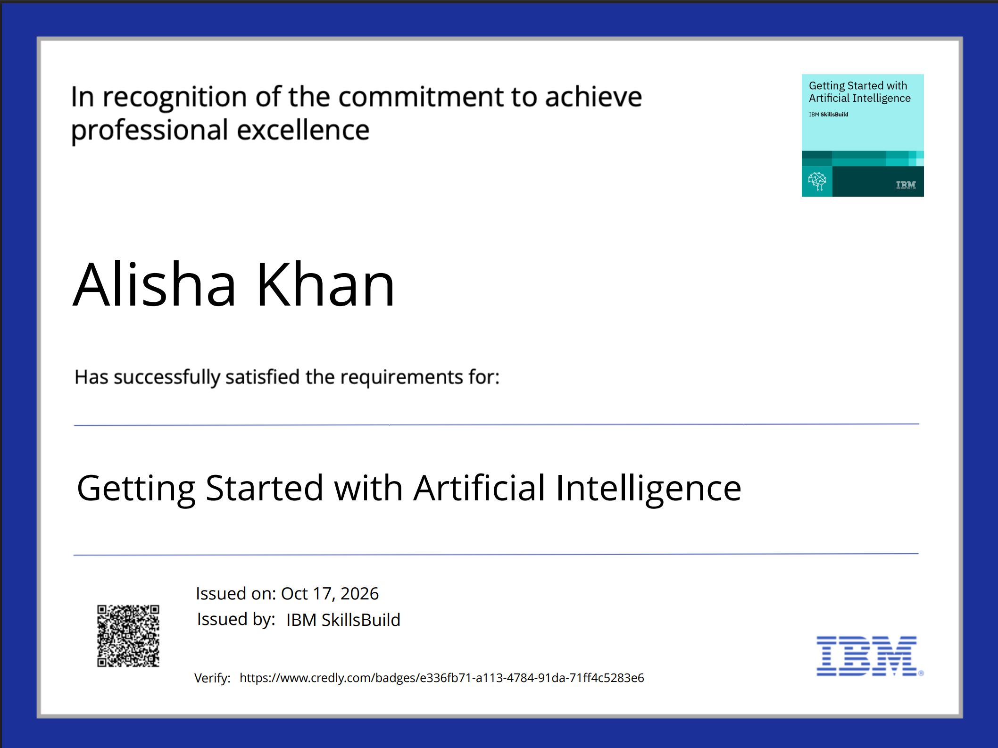
Certificates Earned:
Please add your credly certificate

Slide 15
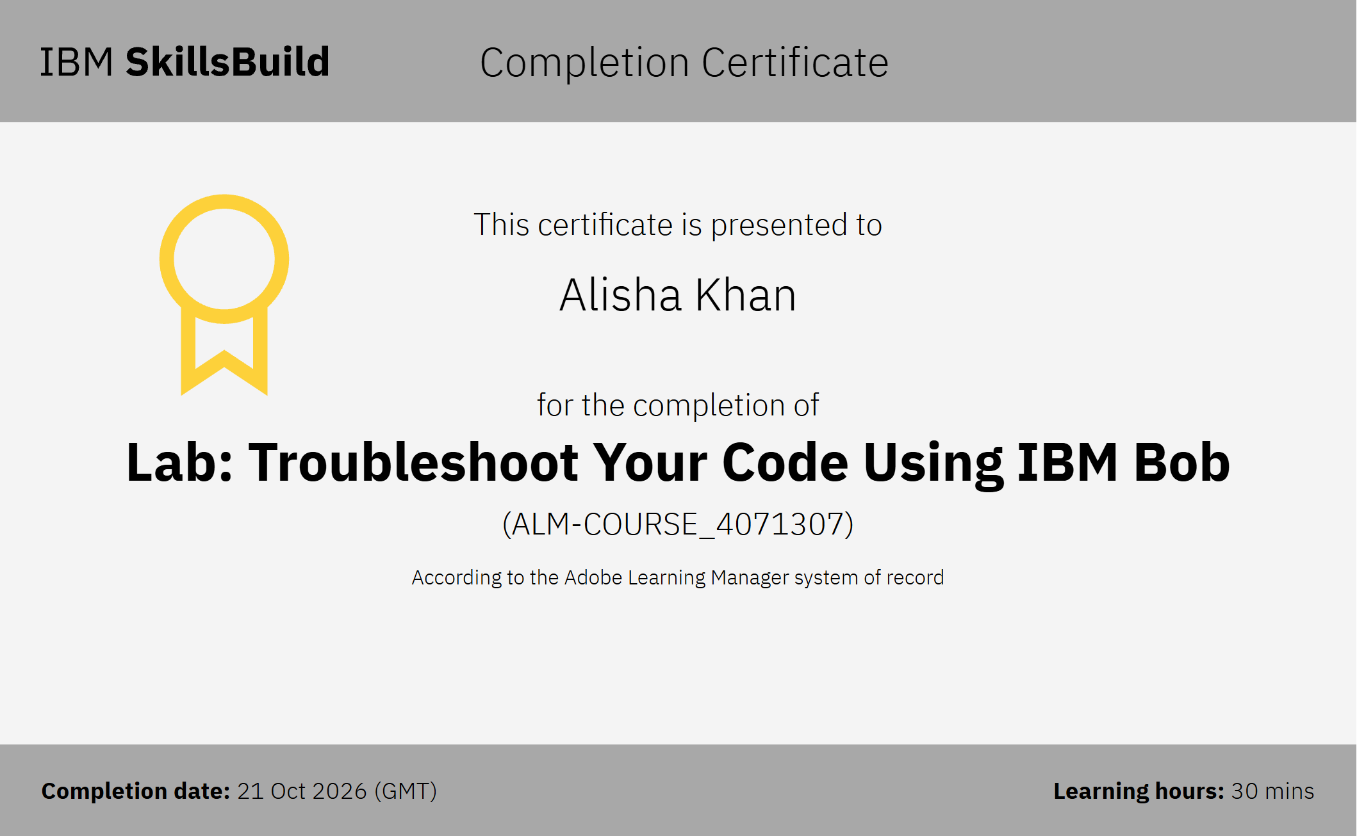
Certificates Earned:​
Add your IBM BOB Certificate

Slide 16


